Slide 1

RISC-V Reward: Building Out-of-Order Processors in a Computer Architecture Design Course with an Open-Source ISA
Steve Zekany*, Jielun Tan*, James Connolly, Ronald Dreslinski
University of Michigan

Slide 2
Redesigning a computer architecture class
Three parts to today’s talk:
Why do this?
What do students learn and do?
What is the scope of design project?
How much work is involved?
What resources do we provide?
What do students think?
(Important context: this class was taught pre-COVID in Fall 2019!)
MIPS R10K CPU die shot (Wikipedia)

Slide 3
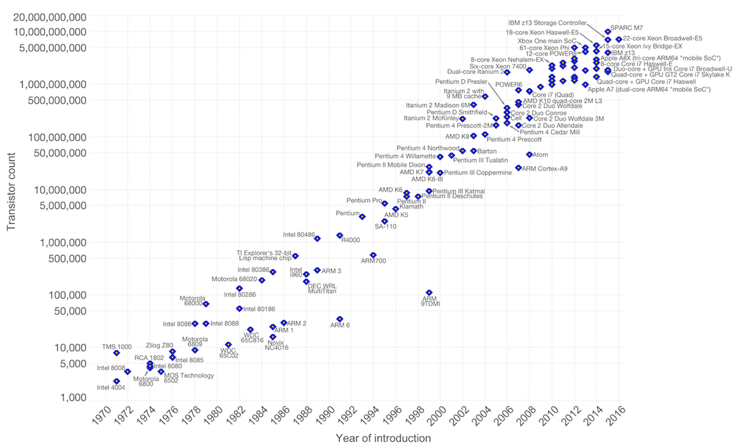
Out-of-Order CPU designs became common around 1995/1996
Single-Cycle & In-Order Pipelined CPUs
Era of Desktop OoO CPUs (c. 1995 – Present)
Mobile OoO CPUs
https://www.techdesignforums.com/practice/files/2017/11/Fig1_Moores-Law.png

Slide 4
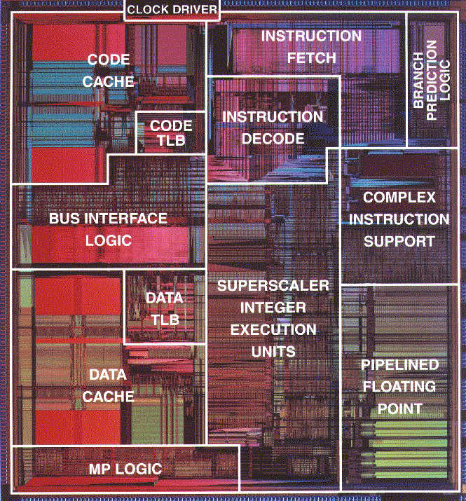

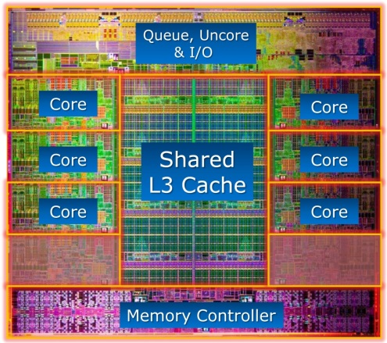




Today: complex CPU Designs
and specialized hardware
4352 Cuda cores!
Intel i7 Sandy Bridge
2012: 6 cores
Apple A12 SoC, 10 cores
Intel Pentium, 1993
Sources: Intel, Apple, NVIDIA
State-of-the-art CPU design is getting harder and more expensive.

Slide 5
Quick Review of In-Order Execution
Only one instruction can be in a stage at a time
LOAD in the Memory stage stalls all successive instructions until the memory operation completes
LOAD M[R1], R2
ADD R4, R5
SUB R6, R7
IF
ID
X
M
M
M
M
W
IF
ID
S
S
S
S
X
W
IF
S
S
S
S
ID
X
W
Pipeline Stall!
Five-Stage Pipeline
Fetch (IF)
Decode (ID)
Execute (X)
Memory (M)
Writeback (W)
–
SUB
ADD
LOAD
–

Slide 6
Out-of-Order Execution
How? Put all instructions into a Reservation Station (dispatch).
Send any available instruction to an available functional unit (issue).
LOAD M[R1], R2
ADD R4, R5
SUB R6, R7
IF
ID
X
M
M
M
M
W
IF
ID
X
W
IF
ID
X
W
When an instruction does not depend on prior instructions, the pipeline does not need to stall
Increased instructions per cycle (IPC) at expense of (massively) increasing complexity of the pipeline.

Slide 7
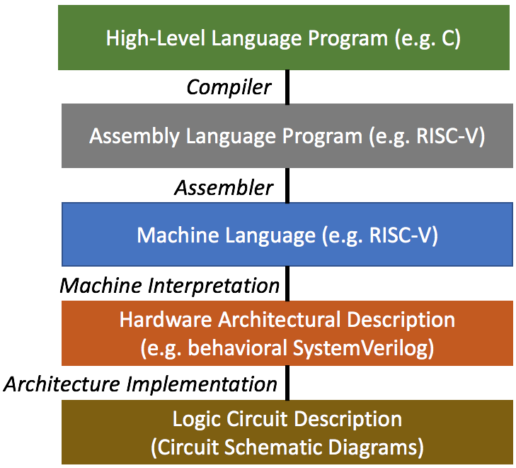
Class Goals & Purpose
We’re interested in where low-level software (assembly & machine code) meets the functional hardware design.
We begin by reviewing in-order pipelines, but move quickly to teach out-of-order (OOO) pipelines in the first half of the course.
Students work in teams during the second half of the course to develop their own OOO CPU designs.
Who takes the class?
Seniors and (ambitious) juniors fulfilling their major design experience requirement. Graduate students, typically first-year.
Students from both the computer science and electrical engineering programs.
Enrollment typically 50-80 students, one faculty lecturer and 2-3 TAs
Semester Timeline
Lecture:
OOO Algorithms and Implementations
Memory Systems and Caches
Special Topics
Coding:
Three Individual Projects
Group Project

Slide 8
Final Project
OoO RISC-V 32-bit processor with branch prediction and L1 cache
Previously alpha64, updated to RV32IM
Written in a Hardware Description Language (SystemVerilog) and synthesizable
Groups of 4-5 students over 8 weeks
Milestone 3
(optional)
Milestone 1
Milestone 2
Project Timeline
Week:
1-2
3-5
6-7
8
Goal:
First module and unit-test
OoO Pipeline
Cache and memory system
Integration and debugging

Slide 9
Final Project
Provided with starter code of an in-order processor, also used for verification
Students will write almost all modules of the OoO pipeline and integrate them
Supports 40 instructions of RV32IM
Can support additional instructions via hardware emulation
Expected to add choices of advanced features to boost performance
Processors need to achieve correct output after executing testing programs
Evaluated on correctness and performance among peers

Slide 10


Why RISC-V?
Open source
Excellent software support
Industry adoption
Simple and modular
Leads to better full-stack understanding
Source: zdnet.com

Slide 11

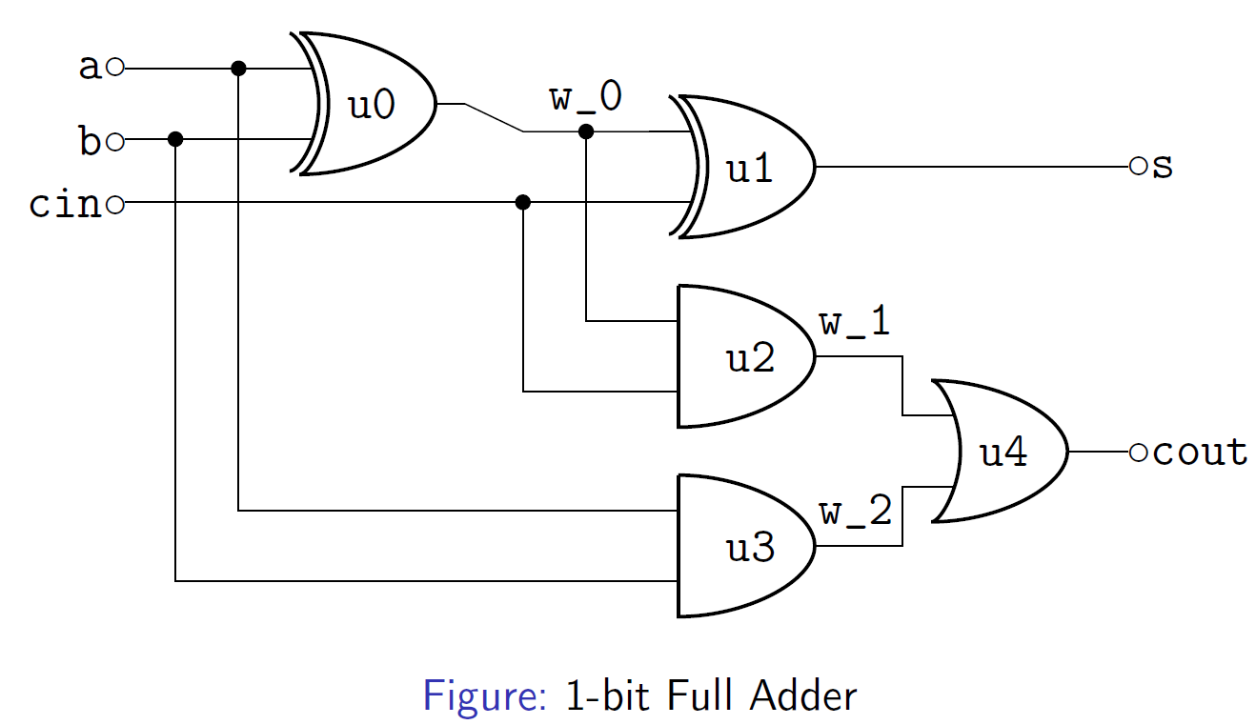
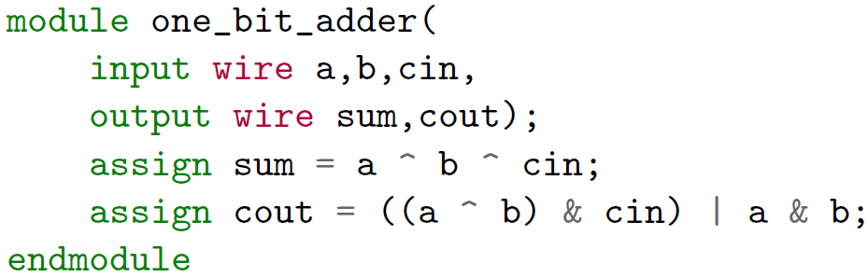
Verilog HDL
Hardware Description Language describes the design of the hardware
In contrast to a programming language like C which describes the movement of data
Can be written in behavioral and synthesized into structural
Behavioral Verilog describes functionality, structural describes construction
We use SystemVerilog, an upgrade to Verilog akin to C++ to C
Behavioral Verilog
Schematic Diagram

Slide 12

EDA Tools
EDA tools are necessary to compile, synthesize and simulate Verilog designs
We use Synopsys VCS for compilation and simulation, Design Compiler for synthesis
All major EDA tool vendors provide university programs with licensing
Alternative open-source tools are available with reduced functionalities

Slide 13

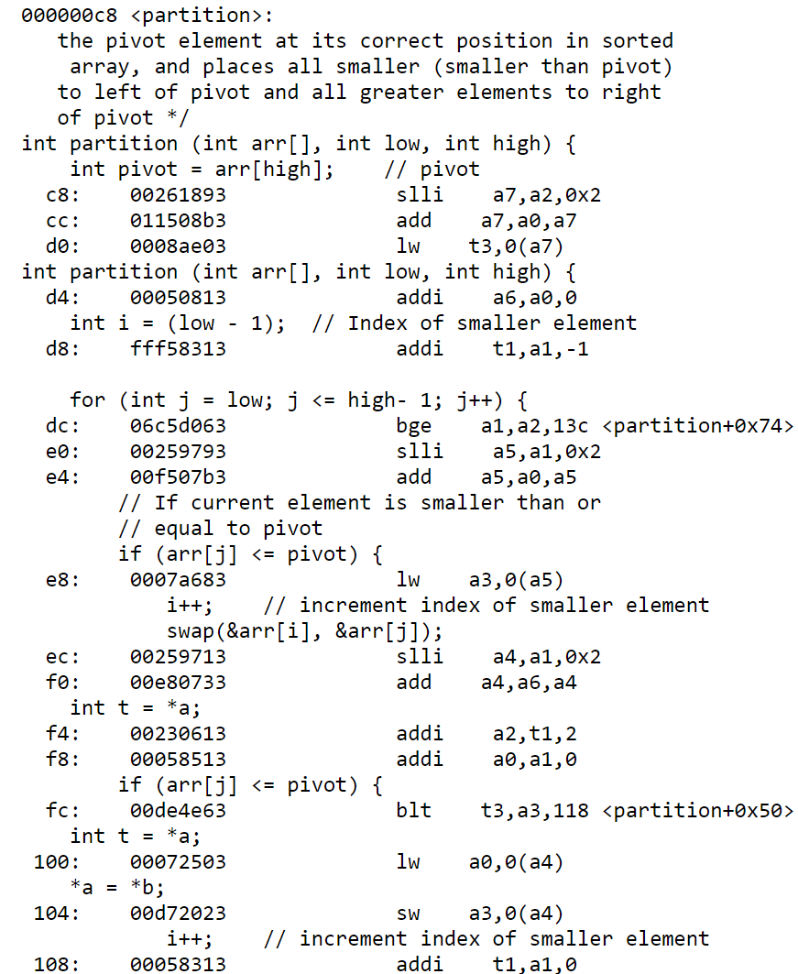
Compiler Support
We use GCC for test program compilation and binary tools for debugging
RISC-V supports the full GNU toolchain
Custom linker for memory allocation and custom runtime for initialization
Allows us to place entire programs within the project's memory space (64 KB)
Define boot behavior
Modular compilation
RISC-V supports compilation only using a subset of its ISA
RV32IM itself supports almost all C libraries
We can compile and run arbitrary programs
objdump of quicksort.c

Slide 14
Testing Environment
Unit test for each module of the pipeline (required in the first milestone)
Assembly and C programs for processor level verification and performance evaluation
Originally only hand-written alpha64 assembly programs were supported
35+ test cases, constantly expanding by inclusion of student submitted test cases
Includes public and private cases
Basic | Functional | Typical | Performance
“Hello world” programs of simple instructions (<50 instructions) | Unpredictable branches and pointer chasing programs to verify specific functionalities (100 – 2,000 instructions) | Common data structures and algorithms in C, e.g. quick sort and linked-list traversal (5,000 – 20,000 instructions) | Large programs such as matrix multiplication and CPU simulations to measure performance (20,000 – 250,000 instructions)

Slide 15
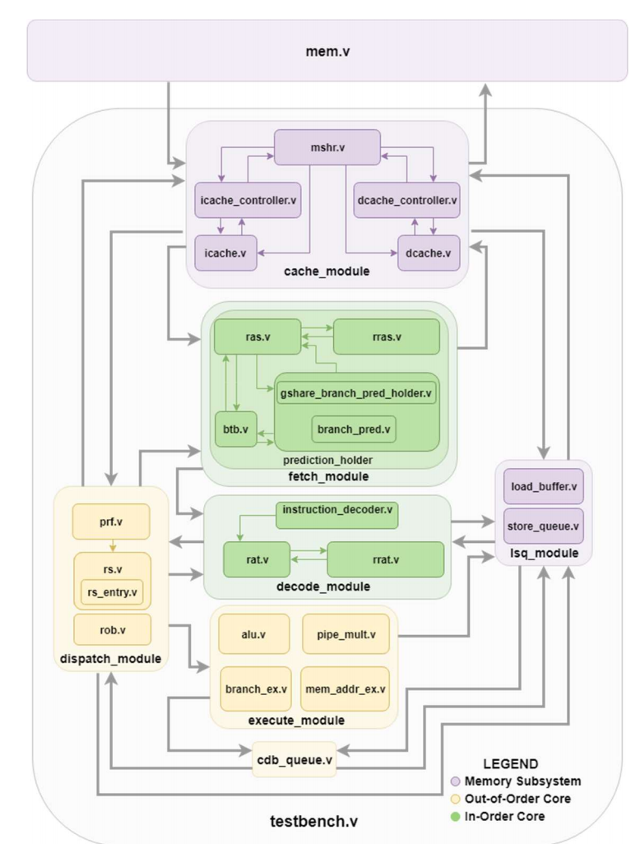
Project Summary
Student groups turn in:
A complete OoO processor that run any programs compiled into RV32IM binaries
Roughly 3,500-5,000 lines of SystemVerilog code
Includes OoO core modules, cache(s), and any advanced features
Test bench for the processor core
Synthesis results (clock period and structural Verilog)
Optional test case(s)
Performance analysis on core and advanced features
We grade projects based on correctness and performance
For performance, we use total execution time to compare groups
Clock period * number of clock cycles required to execute all instructions
Functional diagram, Group 1 Winter ‘18

Slide 16
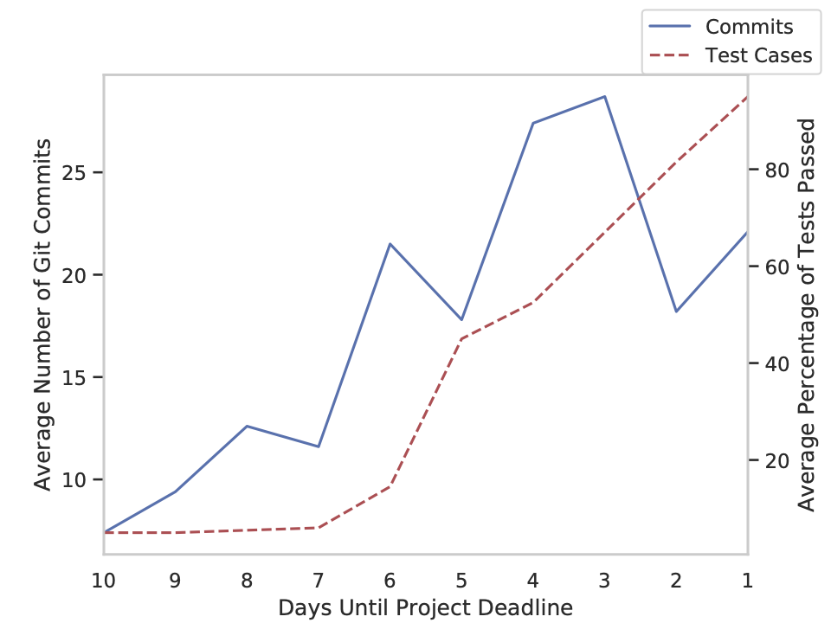
Project Statistics
Most groups finish the project and do quite well.
Many groups pass all the test cases, including (hard) hidden cases.
Average group passes all but one or two.
Many groups don’t pass a majority of the test cases until a few days prior to the deadline.
Even one bug can stop a group from passing most test cases
Formatting issues

Slide 17
Student Feedback
We surveyed students to see how they self-evaluated their skills and the class.
Students reported being substantially more comfortable with computer architecture concepts (average of 4.62/5) and writing Verilog (4.26/5).
Most students (72%) were more interested in computer architecture design and/or research.
56% of students reported using the RISC-V compiler to design their own test cases.
Among this subgroup, 55% reported it being either “somewhat valuable” or “very valuable” to their debugging project (overall average 3.69/5).
“In a phrase or sentence, what did you like about the final project?”
“Seeing how it all fits together.”
“Spending all night in the library with my team members.”
“It ending.”
“Team communication.”
“Good sense of accomplishment when it was over.”
“The fact that it is a fully functional product – you can feed any
instructions into it and it will work – felt rewarding.”
“I found it all to be quite fun.”
“It increased my understanding exponentially.”
“A substantial leap in knowledge.”
“Actually implementing the concepts.”
“The amount of time I spent on this project was
worthwhile because I learned things that can only be
learned practically.”

Slide 18
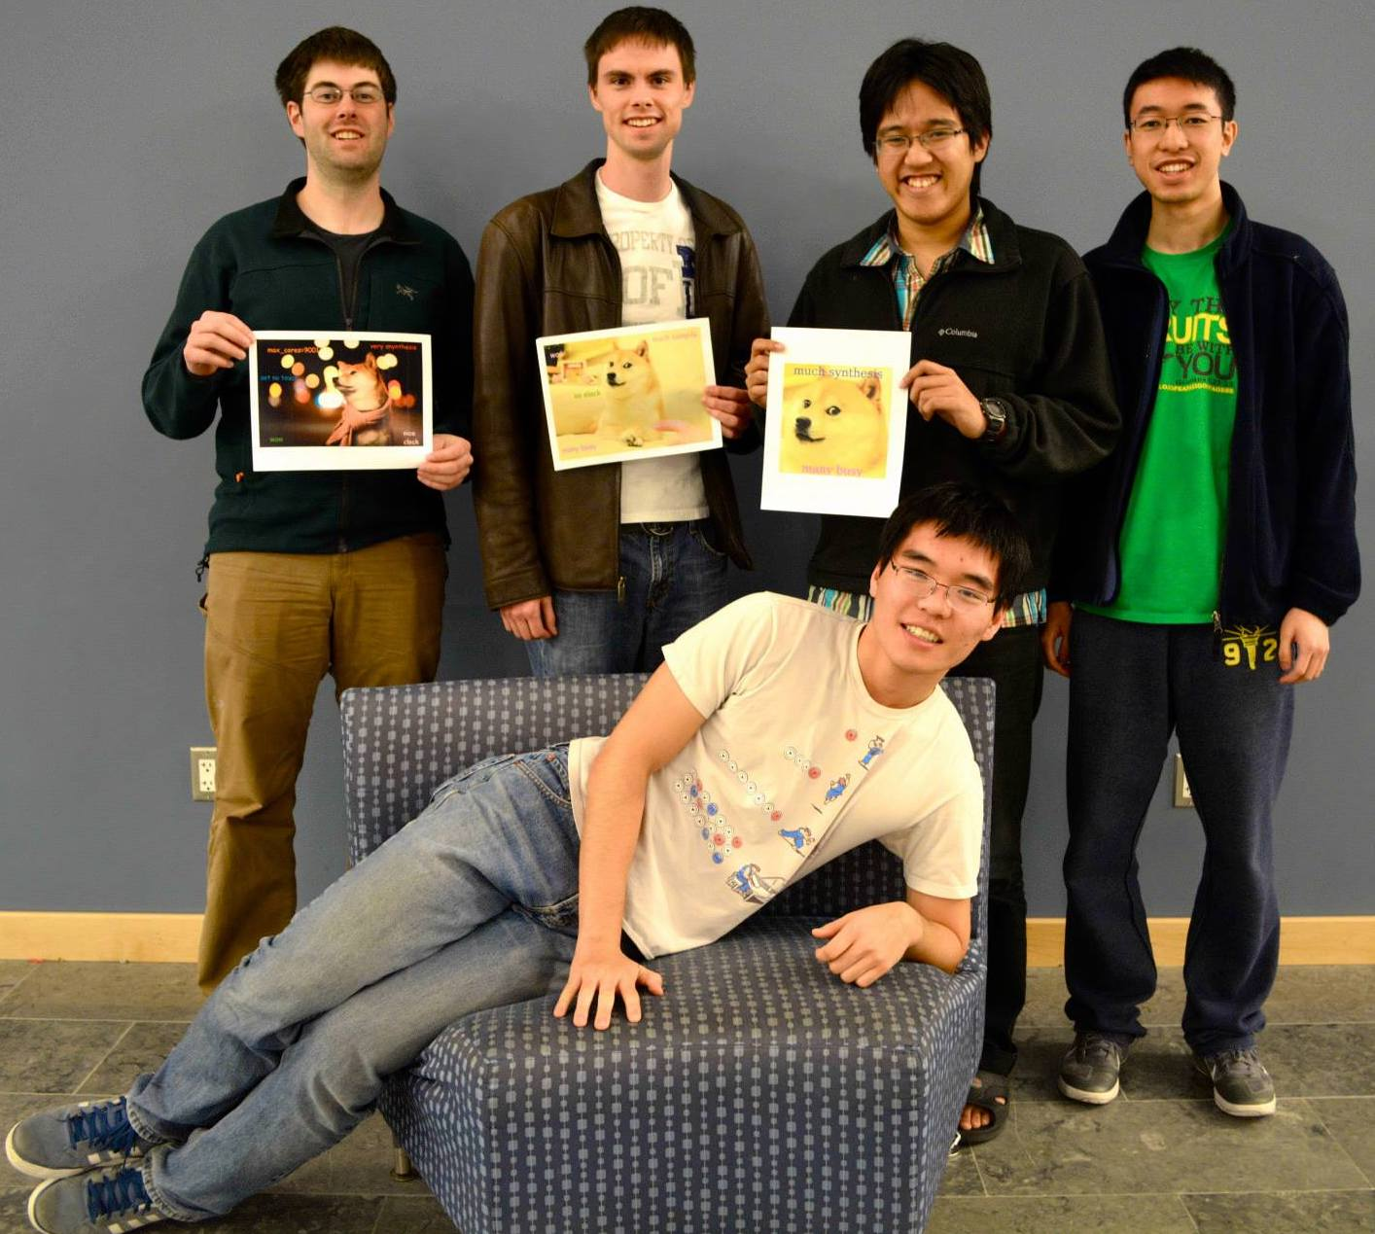
Conclusion
Teach computer architecture aligned with modern architectural case studies
A hands-on, directed team project to design and implement modern OoO processors
Compiler tools to support student groups
We have open-sourced our project and lab materials
https://github.com/jieltan/OpenCompArchCourse
Co-author Steve Zekany (left) with his project group circa 2014

Slide 19
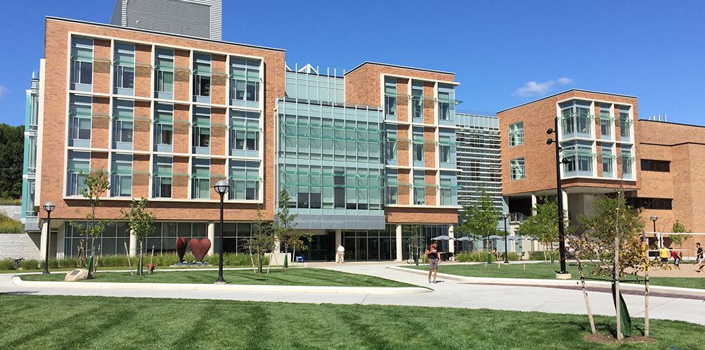
Thanks to everyone who helped along the way!
Austin Rovinski, who beta-tested the new project spec and tools
Siying Feng and Xueyang Liu, who TA'd the class after the course change
Jon Beaumont and Will Cunningham, who developed many of the materials
Tom Wenisch, Mark Brehob, and the other lecturers who taught the class over the years
The SIGCSE reviewers, for their valuable time and comments
And finally: the students who participated in the project in Winter and Fall 2019, without whom none of this would be possible

